Slide 1
3D Viewing, Parallel Projection, Perspective Projection & Shading Model

Slide 2

3D Viewing Pipeline
Modelling Coordinates
Modelling Transformation
World Coordinates
Viewing Transformation
Viewing Coordinates
Projection Transformation
Projection Coordinates
Workstation Transformation
Device Coordinates

Slide 3

Projection

Slide 4
Perspective Projection
Generating a view of a three dimensional scene is to project points to the display plane along converging paths.

Slide 5
Perspective Projection
Parallel lines in a scene that are not parallel to the display plane are projected into converging lines.
Scenes displayed using perspective projections appear more realistic.
Way that our eyes and a camera lens form images.

Slide 6
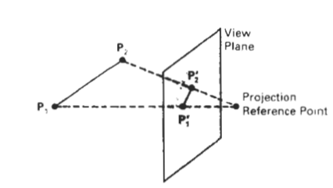
Perspective Projection

Slide 7
Parallel Projection
Generating a view of a solid object is to project points on the object surface along parallel lines onto the display plane.

Slide 8
Parallel Projection
Parallel lines in the world-coordinate scene projected into parallel lines on the two-dimensional display plane.
This technique is used in engineering and architectural drawings to represent an object
Maintains relative proportions of the object.

Slide 9
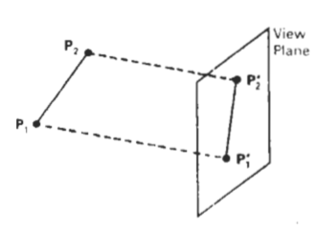
Parallel Projection

Slide 10
Parallel Projection Types
Orthographic
Perpendicular to view plane
Oblique
Any other angle made with view plane

Slide 11
Orthographic Parallel Projection
Often used to represent front, side or top view of object
Engineering and Architectural designers use this type

Slide 12
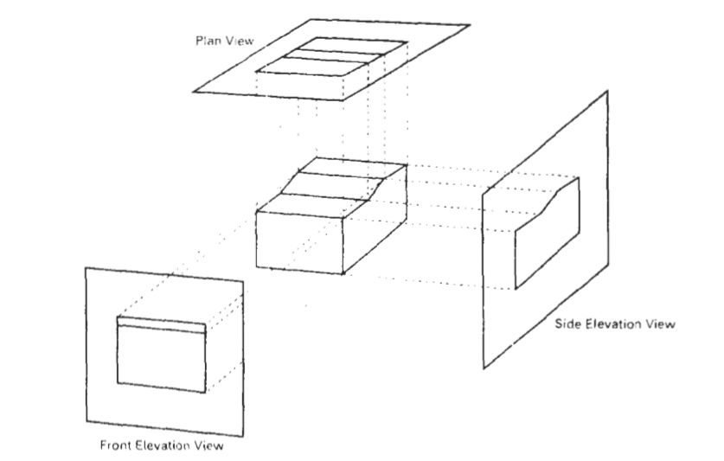
Orthographic Parallel Projection

Slide 13
Axonometric Orthographic Projection
Orthographic projections that display more than one face of an object is called axonometric orthographic projections.
Most common axonometric projection is the isometric projection.

Slide 14
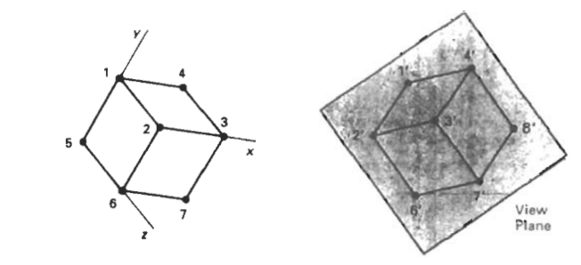
Isometric Projection

Slide 15
Mathematics for Projection

Slide 16
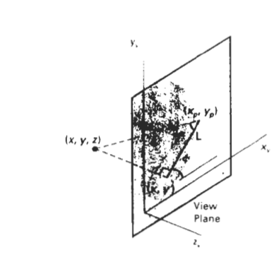
Oblique Projection
X_{p} = X + Lcosø
Y_{p} = Y + Lsinø
Length L depends on the angle ∂ and the z coordinate of the point to be projected:
tan∂ = z/L
L = z/tan∂ = zL₁
Where L₁ is inverse of tan∂
Above equation can be written as:
X_{p} = X + zL₁cosø
Y_{p} = Y + zL₁sinø

Slide 17
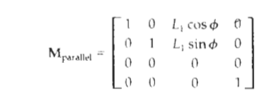
Parallel Projection Matrix
L₁ = 0 represents orthographic
Otherwise it represents oblique Projection.

Slide 18
Cavalier and Cabinet Projection
if tan∂ = 1 then it is cavalier Projection
If tan∂ = 2 then it is cabinet Projection

Slide 19
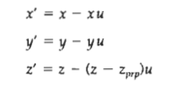
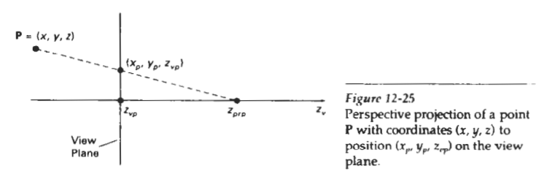
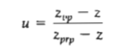
Perspective Projection

Slide 20
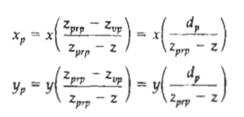
Perspective Projection Contd.

Slide 21
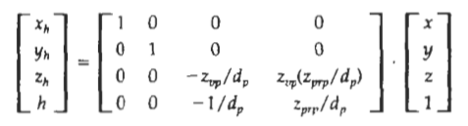
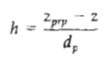
Homogeneous Matrix Representation of Perspective Projection

Slide 22

Next: Shading Model

Slide 23
Shading Models
Constant Shading
Gauroud Shading
Phong Shading

Slide 24
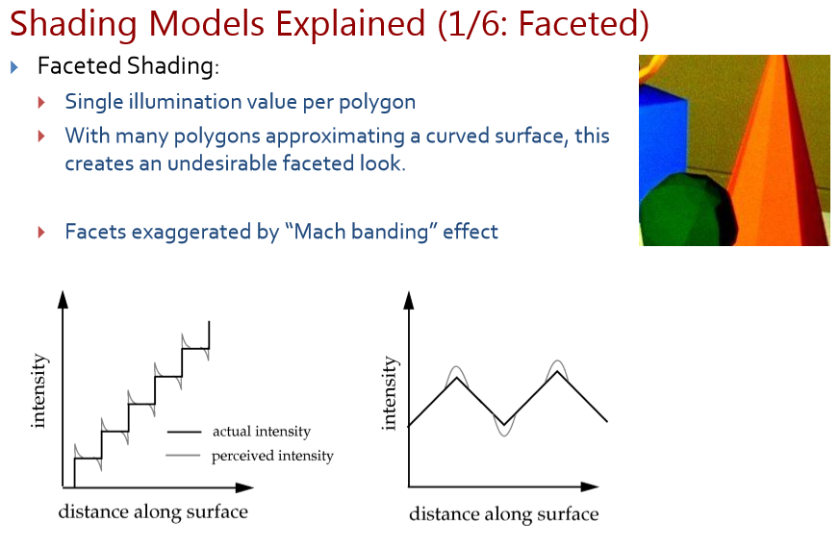

Slide 25
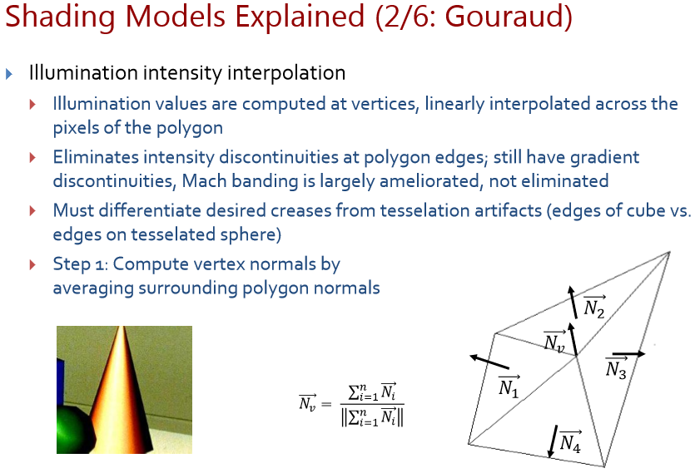

Slide 26
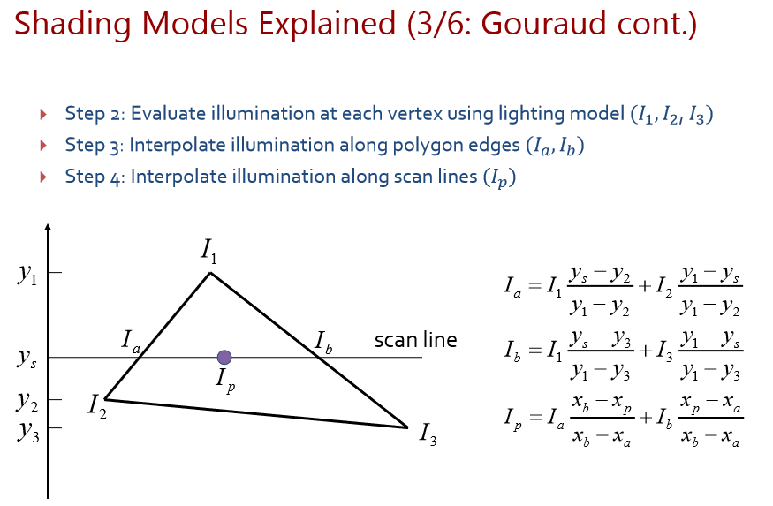

Slide 27
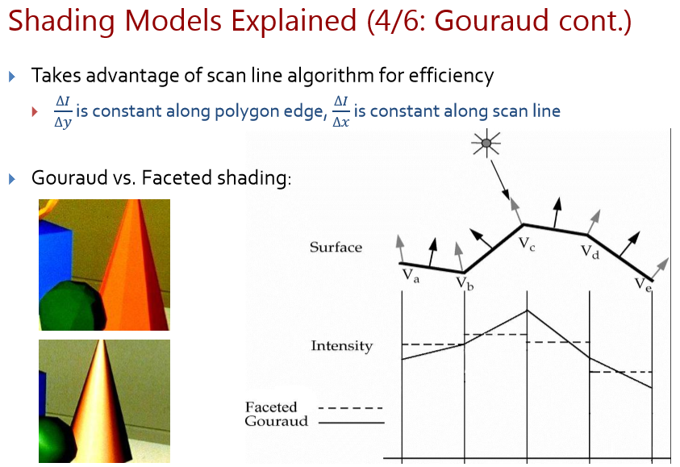

Slide 28
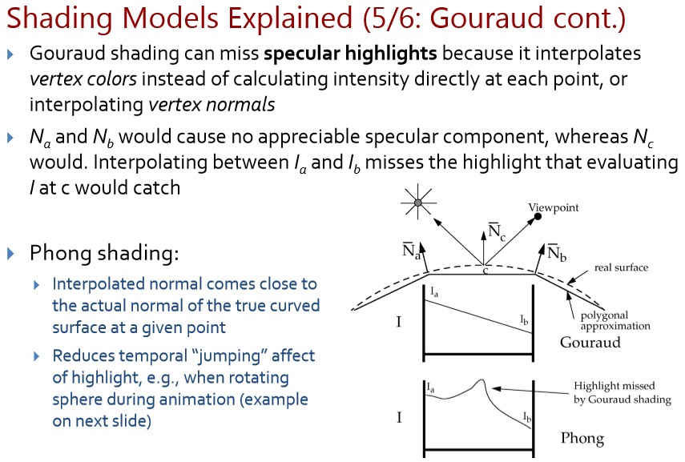

Slide 29
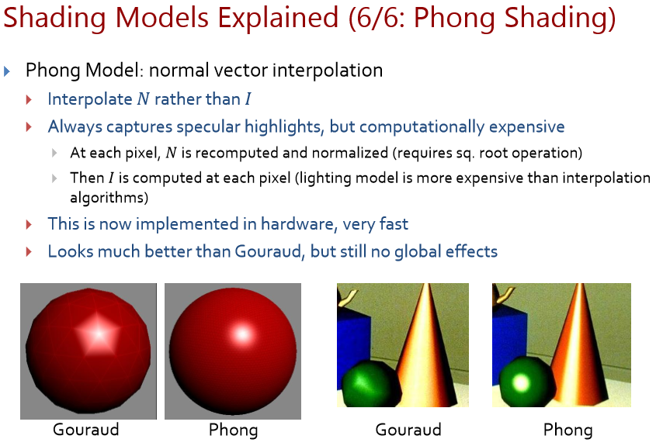

Slide 30
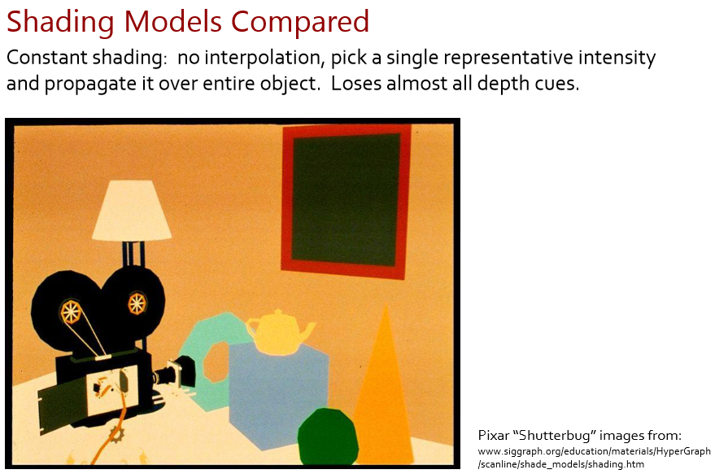

Slide 31
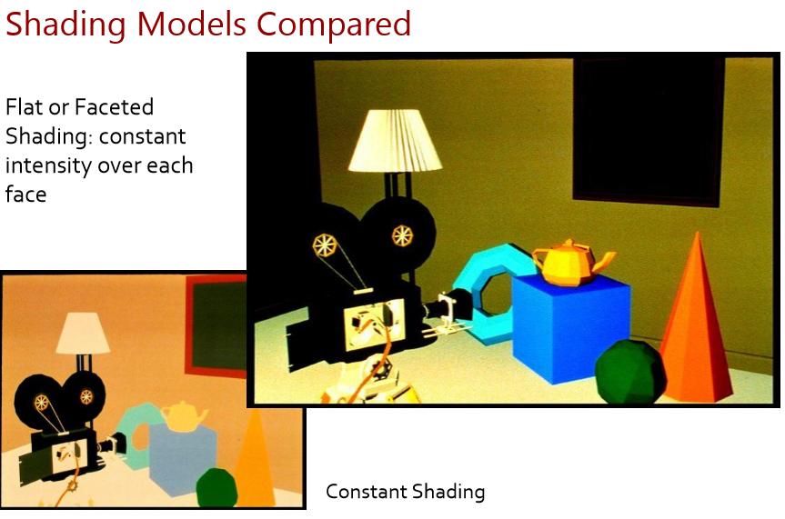

Slide 32
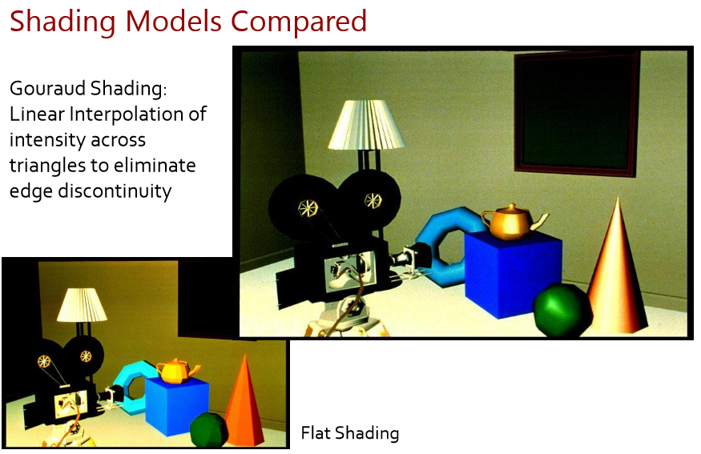

Slide 33
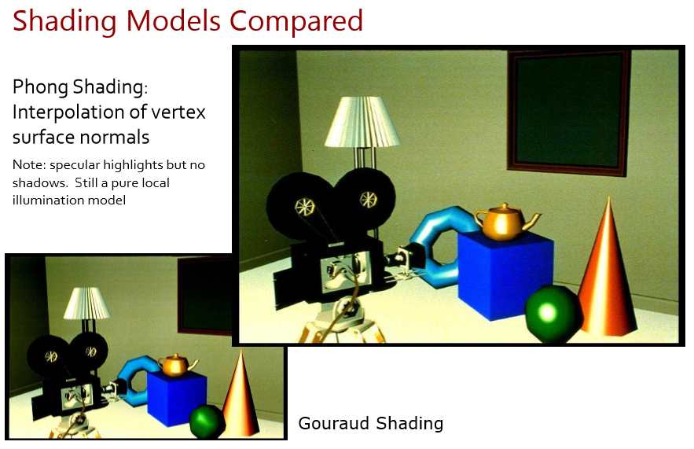

Slide 34
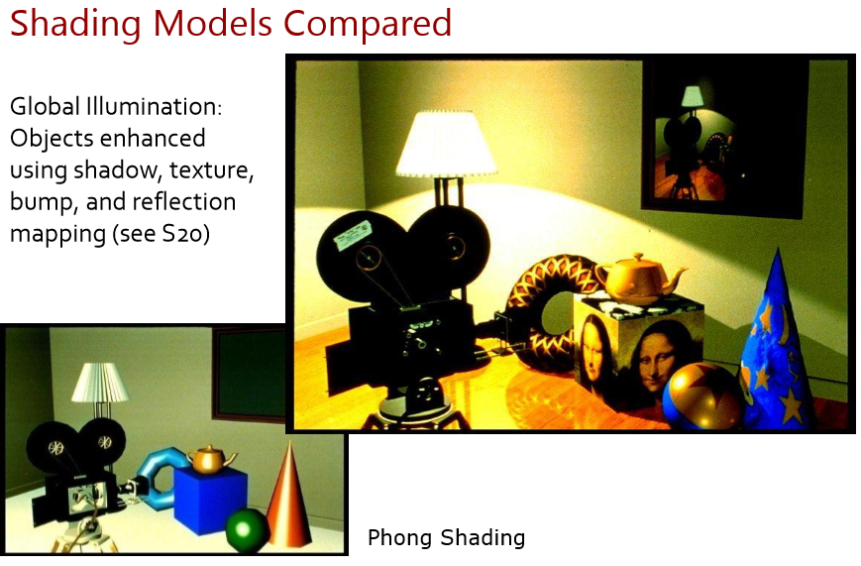

Slide 35

Thank You

